Slide 1
Credit EDA Case Study
By:
- Nikhil Birari
- Rashmi Bennur

Slide 2
Objective
This case study aims to identify patterns which indicate if a client has difficulty paying their installments which may be used for taking actions such as denying the loan, reducing the amount of loan, lending (to risky applicants) at a higher interest rate, etc.
The company wants to understand the driving factors (or driver variables) behind loan default, i.e. the variables which are strong indicators of default. Which controls loss of business to the company and avoid financial loss for the company.

Slide 3
Steps
Data sourcing & inspecting
Checking data quality and cleaning, binning
Data analysis by univariate and bivariate analysis
Finding Correlations
Merging application data with previous application data
Data analysis by univariate and bivariate analysis
Multivariate analysis & Finding Correlations
Observations & Summary

Slide 4
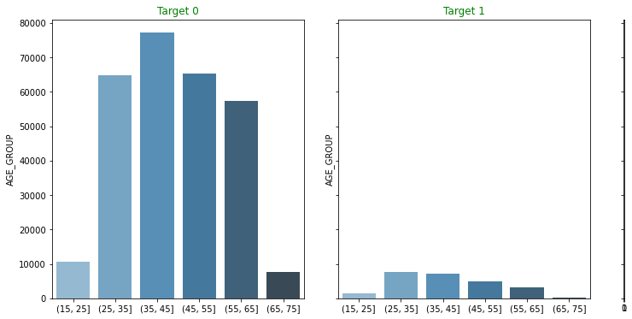
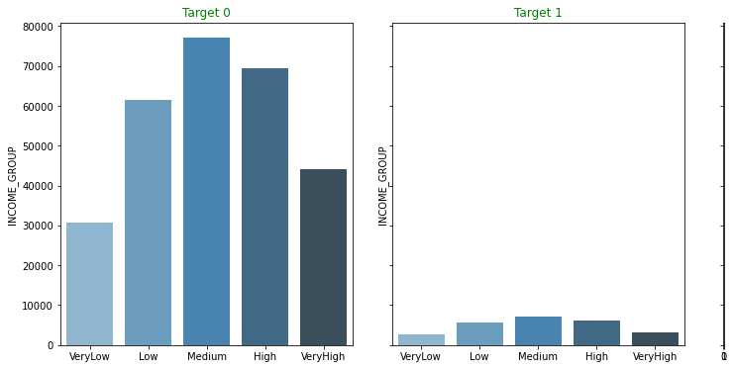
Age & Income
First graph shows age group 35-45 are more in without payment difficulty. In payment difficulty 25-35 have higher share. Age does seem like influencing default.
Medium income group have more count in both the categories.

Slide 5
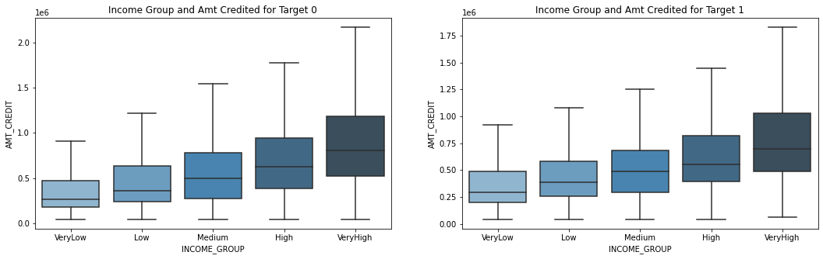
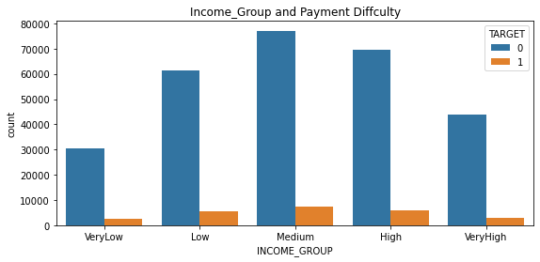
Income & Credit
We can infer that though the maximum no of loans are given to Medium income group, default value per loan is highest in High income group as the 'AMT_CREDIT' is higher too. The loan book of the financial institution can get affected due to higher amount not being paid back.

Slide 6
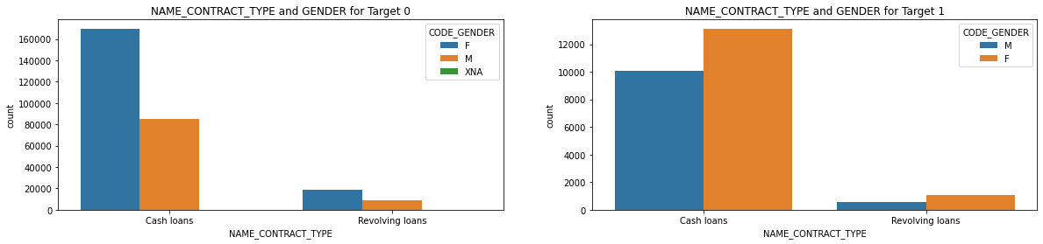
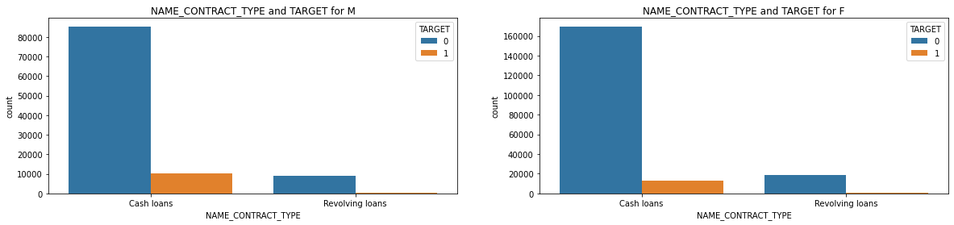
Male & Female
Though male applicants are lower, ratio of male applicants defaulting is higher.

Slide 7
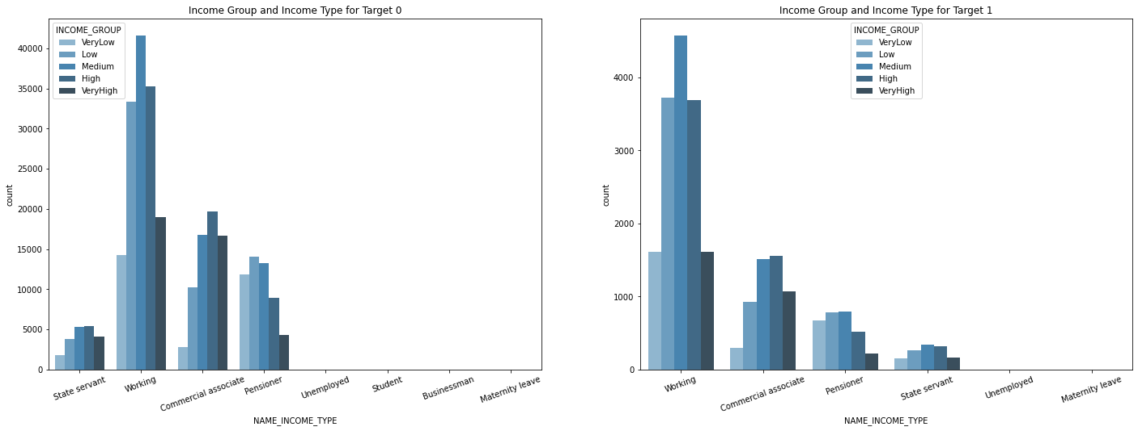
Income group & type
Medium income group with income type working has almost 1 in 12 defaults. Higher than the average 1 in 11 defaults.

Slide 8
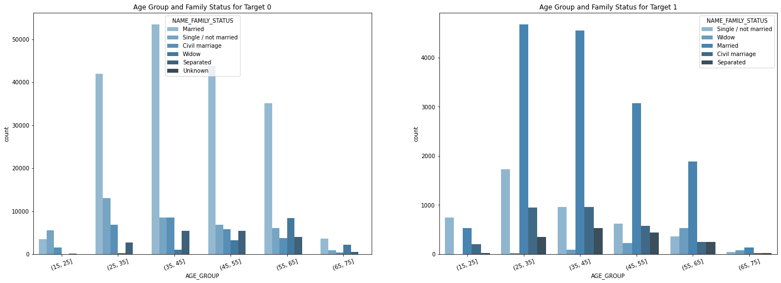
Age & Family status
Married applicants in the age group 25-35 and 35-45 are the largest group of applicant with payment difficulties.

Slide 9
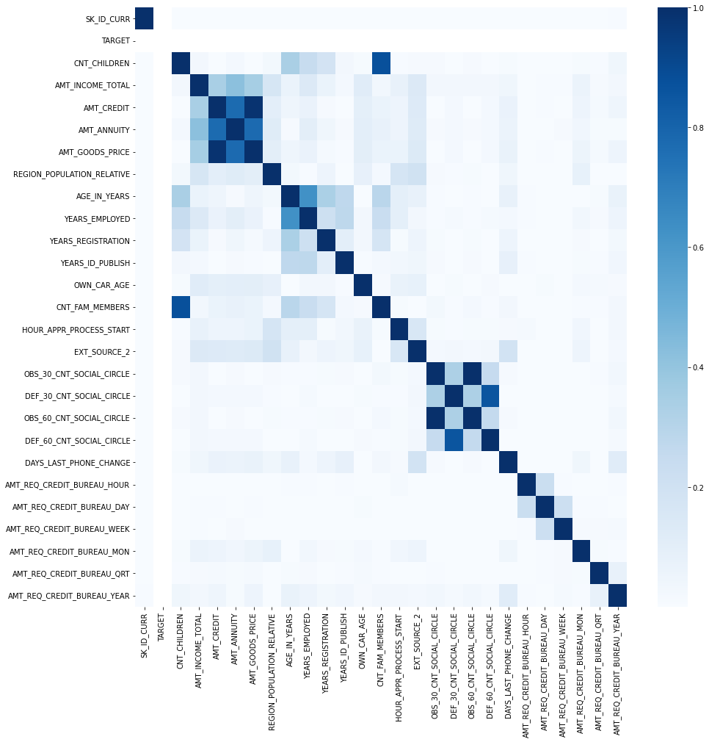
Correlations
These are definitely correlated. We can also see that its higher and steeper for Target 1, signifying that in approval process this parameter must be strongly looked into.
'AMT_CREDIT' and 'AMT_GOOD PRICE' don't seem to be increasing in proportion with 'AMT_INCOME' for TARGET 1, thus possibly leading to default.

Slide 10
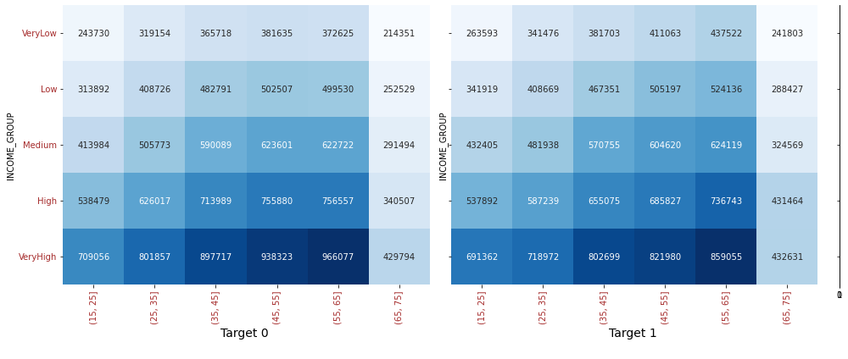
AMT_CREDIT with Age group and Income group
Age Group 55-65 in Very High income group has high amount credit. As explained above, this could result as loss in loan book.

Slide 11
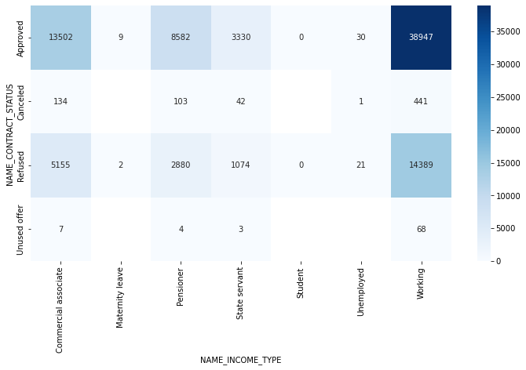
Merged dataset analysis
Working applicant with Approved status have defaulted in highest numbers.
14,389 applicants of working class were REFUSED earlier and now have defaulted

Slide 12
Summary
Defaulters' demography
All the below variables were established in analysis of Application dataframe as leading to default. Checked these against the Approved loans which have defaults, and it proves to be correct.
- Medium income
- 25-35 years old , followed by 35-45 years age group
- Male
- Unemployed
- Laborer's, Salesman, Drivers
- Business type 3
- Own House - No
Other IMPORTANT Factors to be considered
- Days last phone number changed - Lower figure points at concern
- No of Bureau Hits in last week. Month etc. – zero hits is good
- Amount income not correspondingly equivalent to Good Bought – Income low and good value high is a concern
- Previous applications with Refused, Cancelled, Unused loans also have default which is a matter of concern.
This indicates that the financial company had Refused/Cancelled previous application but has approved the current and is facing default on these.

Slide 13
Summary
Credible Applications refused
- Unused applications have lower loan amount. Is this the reason for no usage?
- Female applicants should be given extra weightage as defaults are lesser
- 60% of defaulters are Working applicants. This does not mean working applicants must be refused. Proper scrutiny of other parameters needed
- Previous applications with Refused, Cancelled, Unused loans also have cases where payments are coming on time in current application. This indicates that possibly wrong decisions were done in those cases.

